Slide 1





Why I Need A
Day Of Play
https://www.carnival.com
BY: [YOUR NAME]

Slide 2
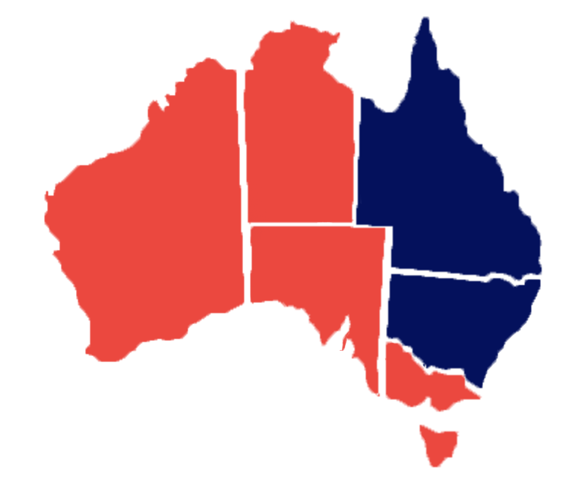


The Problem:
QLD & NSW have the fewest public holidays in Australia.
Meanwhile Victoria’s out here long-weekending every second Tuesday for “Cup Day” or someone’s cousin’s birthday.

Slide 3
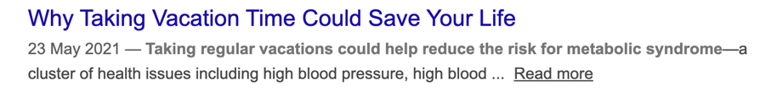

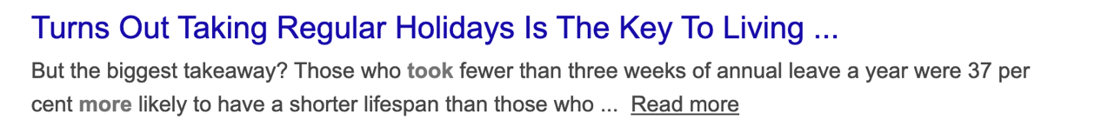

FACT: “Staying reachable” is how your day off accidentally becomes a workday in trackies.
Science agrees. Taking a proper day off is the key to staying happy n’ healthy.

Slide 4

Why This Matters:
Don't you feel like we've all lost our sense of childlike wonder?
Our sense of play?
Sometimes we need to do things just for the fun of it.
Remember... FUN?
A little playtime is just what I need to come back better than ever.

Slide 5
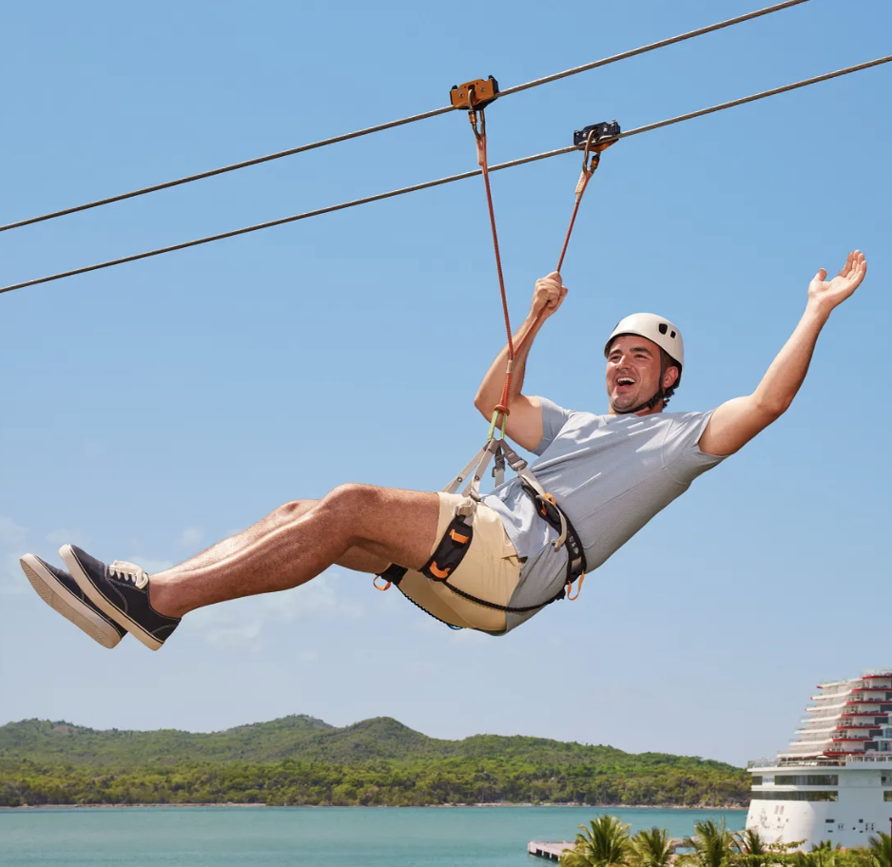
The Big Idea:
Crazy thought…
What if a day off
was actually
a day off?
I know. Wild.

Slide 6


The ROI:
An uninterrupted holiday = Better vibes.
AKA, when my time off is for fun, not chores, I come back happier, sharper, and far less likely to spiral before Monday.
Big red arrow goes up!!!!!
Happiness Index

Slide 7
Risk Assessment:
Based on comprehensive modelling, scenario planning, and a robust multi-variable vibe analysis, the projected risk profile sits firmly in the “negligible to non-existent” range.
Projected outcomes suggest strong ROI in energy, engagement, and overall human happiness metrics if you help me take a real holiday.
MAX HAPPINESS
No Risk
Extremely
Low risk
Risk likelihood
MAX HAPPINESS
Low risk
Low
Medium
High
Impact

Slide 8

Implementation Plan:
STEP 1
STEP 2
I TAKE
A HOLIDAY
FULL OF PLAY
EVERYONE
BENEFITS

Slide 9
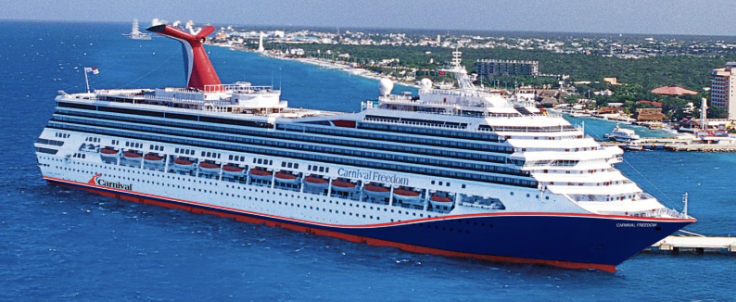
In Conclusion:
Time away.
Zero responsibilities.
With a slightly sunnier version of me sailing back home.
Well-rested, well-fed, and hopefully remembering where I left my keys.
Pretty good deal, really.
So please let me play away for the day.

